Slide 1
TravelNest Platform
Data Engineering PowerPoint based exactly on notebook outputs
Strategic question
What drives booking revenue and customer lifetime value, and how do accommodation quality, cancellation behaviour, and geography impact long-term platform performance?
55,550
Star schema
€64.03M
7
Raw -> Bronze -> Silver -> Gold
Fact rows
Gold model
Revenue base
Visualisations
One clean analytical model for revenue, CLV, quality, cancellations and geography
Chaybon Verlooy – BADI 2
Google Colab · PySpark · Spark SQL · Delta Lake MERGE · Matplotlib/Seaborn

Slide 2
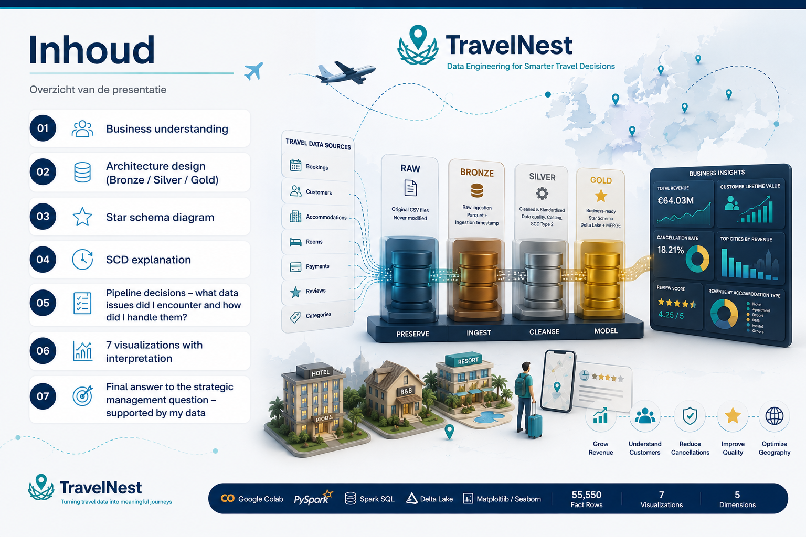
02

Slide 3
1. Business understanding
Management question translated into measurable analytical drivers.
Business objective
Data sources used
Build a Medallion data pipeline and produce evidence-based insights on revenue, customer lifetime value, quality, cancellations and geography.
bookings.csv
customers.csv
accommodations.csv
rooms.csv
payments.csv
reviews.csv
accommodation_categories.csv
Core drivers in the notebook
Accommodation type
Customer behaviour
Geography
Revenue by category and property type
CLV, top customers, repeat booking value
Country cancellation rates and city revenue
Quality
Cancellations
Review score vs revenue correlation
Completed, no-show, late and on-time classification
Source: TravelNest_Medallion_Complete.ipynb
03

Slide 4
2. Architecture design — Bronze / Silver / Gold
Notebook implementation: Raw CSVs are ingested, cleansed and modelled into Delta Gold tables via MERGE.
RAW
BRONZE
SILVER
GOLD
Original CSV files
Parquet raw ingestion
Cleaned & standardised
Delta star schema
Never modified
Schema/string preservation + ingestion_timestamp
Casting, null handling, DQ decisions, SCD2
MERGE/upsert only, business-ready KPIs
Implementation facts from notebook
55,550 rows
Bronze
all seven CSV files loaded as-is and saved as Parquet
Gold fact_bookings
Silver
standardised names, types, dates, currencies and data-quality issues
Gold
dim_customer, dim_accommodation, dim_room, dim_geography, dim_date, fact_bookings
5 dimensions
Upsert
Gold Delta tables are maintained with MERGE, no full overwrite
Gold dimensions
Source: TravelNest_Medallion_Complete.ipynb
04

Slide 5
3. Star Schema Diagram
dim_accommodation
accommodation_key
accommodation_name
category
city
country
451 rows
Fact grain: one row per booking transaction
fact_bookings
booking_id (PK)
booking_date
room_key (FK)
customer_key (FK)
accommodation_key (FK)
geography_key (FK)
date_key (FK)
revenue
refunded_amount
payment_count
currency_conversion_issues
nights
booking_status
cancellation_flag
cancellation_class
lead_time_days
review_score
55,550 rows
dim_customer
customer_key
customer_unique_id
customer_name
city
country
valid_from
valid_to
is_current
11,001 rows
dim_geography
geography_key
city
country
country_code
50 rows
dim_room
room_key
room_type
capacity
price_per_night
1,094 rows
dim_date
date_key
day
month
quarter
year
1,025 rows
Gold layer implemented using Delta MERGE upserts (no overwrite).

Slide 6
4. SCD Type 2 Implementation
Historical customer changes are preserved instead of overwritten
Example:
Historical customer row
customer_unique_id = C102
city = Paris
valid_from = 2021-01-01
valid_to = 2023-05-01
is_current = false
Customer
attribute changed
Current customer row
customer_unique_id = C102
city = Brussels
valid_from = 2023-05-01
valid_to = 9999-12-31
is_current = true
Why this matters:
Customer Lifetime Value remains historically accurate even when customer attributes change.
Notebook implementation: multiple records with the same customer_unique_id are interpreted as historical versions.

Slide 7
5. Pipeline decisions - data quality issues and handling
Exact issue counts and handling decisions shown in the notebook before Silver cleaning.
Source
Issue found
Records
Handling
customers
missing city values
220
Filled with Unknown
bookings
missing customer_id values
277
Linked to unknown customer key 0
rooms
null or non-positive prices
22
Median price imputation
reviews
ratings outside 0–10
492
Converted impossible scores to null
reviews
cleanliness outside 0–10
131
Converted impossible scores to null
payments
missing payment methods
490
Filled with unknown
payments
multiple payment currencies
3
Converted to EUR with fixed FX rates
Other modelling decisions
• 718 booking records had nights different from calculated stay duration. Nights were recalculated from check-out minus check-in.
• Accommodation type spelling issues such as Ressort, Hostle and Appartment were standardised.
• Multiple payment rows per booking were aggregated before fact creation to avoid duplicate revenue.
• Missing or empty special_requests were filled with none.
Source: TravelNest_Medallion_Complete.ipynb
07

Slide 8
Advanced requirements - cancellation KPI, lead time and window functions
Notebook calculations beyond the mandatory visualisations.
Cancellation class
Bookings
Revenue
Share
Lead-time segment
Bookings
Revenue
Cancel rate
Completed
38,818
€54.75M
69.88%
Last-minute (0–7d)
2,389
€2.71M
18.21%
On-time cancellation
8,046
€0.00M
14.48%
Short (8–30d)
7,039
€8.18M
18.27%
Confirmed / active
6,703
€9.29M
12.07%
Medium (31–90d)
18,456
€21.37M
17.93%
No-show
1,620
€0.00M
2.92%
Long (91+d)
27,666
€31.78M
18.07%
Late cancellation
363
€0.00M
0.65%
Important KPI limitation
Window functions used
The source does not contain an actual cancellation_date. The notebook therefore uses lead_time_days = check_in_date − booking_date as a transparent proxy for cancellation timing. This should be interpreted as booking-risk classification, not a perfect operational cancellation timestamp.
ROW_NUMBER() for surrogate keys and latest review selection.
SUM() OVER() for customer lifetime revenue.
RANK() for top customers by lifetime revenue.
Source: TravelNest_Medallion_Complete.ipynb
08

Slide 9
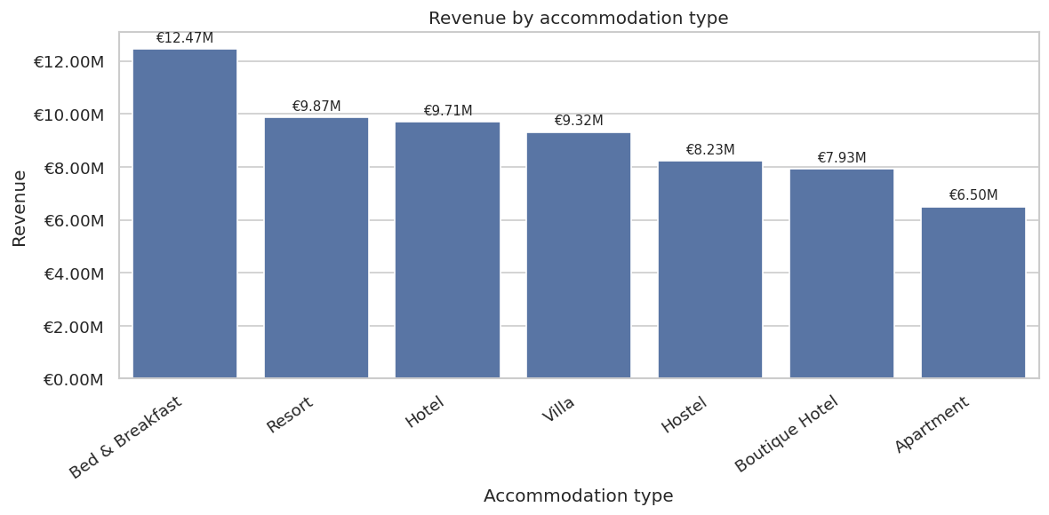
6. Revenue by accommodation type
Why: bar chart compares total revenue across all accommodation types and shows product revenue drivers.
Notebook interpretation
Bed & Breakfast generated the highest revenue with €12.47M, followed by Resort with €9.87M. Apartment generated the lowest revenue with €6.50M. Revenue is diversified across categories, so TravelNest is not overly dependent on one property type. Bed & Breakfast and Resort should be prioritised for partnerships, promotions and marketing investment.
Source: TravelNest_Medallion_Complete.ipynb
09

Slide 10
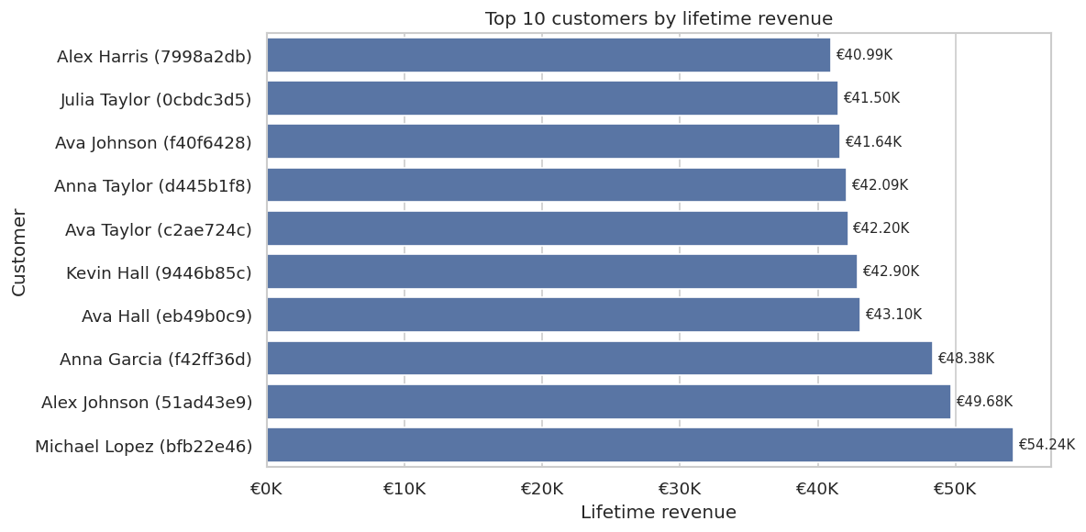
7. Top 10 customers by lifetime revenue
Why: ranking highlights individual customers contributing most to long-term platform performance.
Notebook interpretation
The highest-value customer is Michael Lopez (bfb22e46), generating €54.24K across 26 bookings. The 10th-ranked customer still generated €40.99K, showing consistently high value rather than one outlier. The notebook groups by customer_unique_id so SCD2 attribute changes do not split lifetime value.
Source: TravelNest_Medallion_Complete.ipynb
10

Slide 11
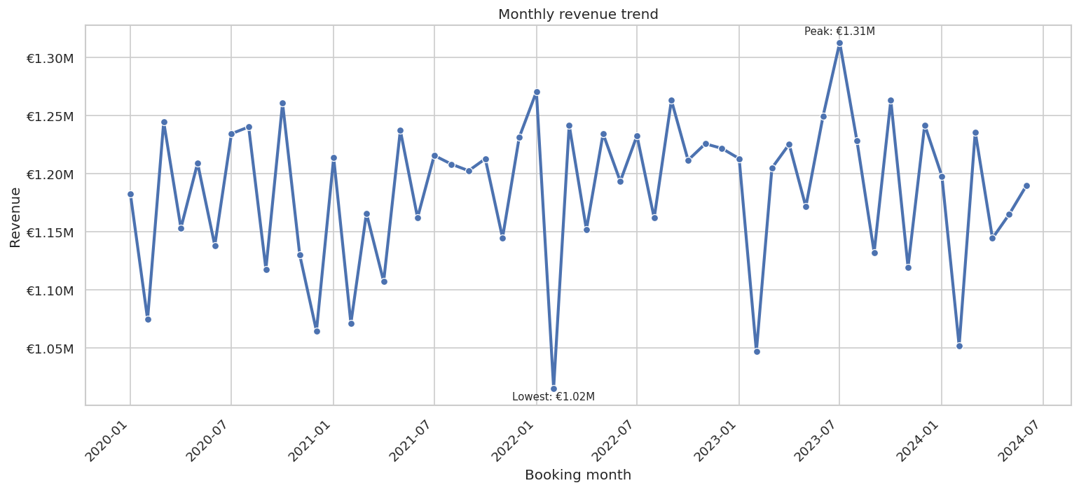
8. Monthly revenue trend
Why: time series reveals seasonality and changes in platform performance over time.
Notebook interpretation
Revenue peaks in July 2023 with €1.31M, while the lowest month is February 2022 with €1.02M. Revenue remains relatively stable, but the difference between peak and low months shows recurring demand fluctuations. Marketing, pricing and supply should align with stronger and weaker demand months.
Source: TravelNest_Medallion_Complete.ipynb
11

Slide 12
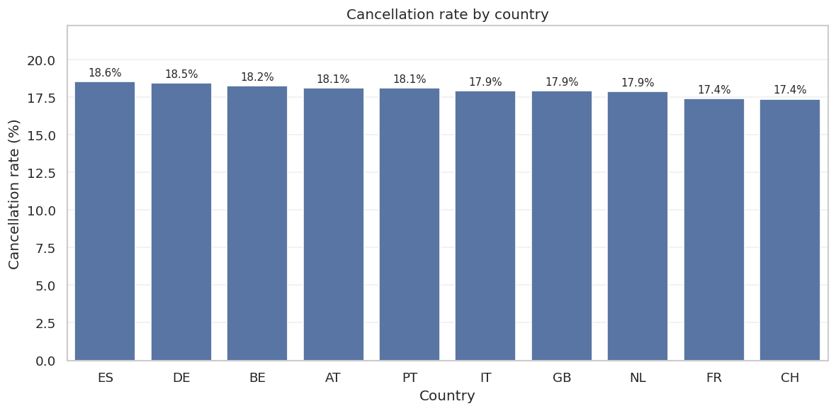
9. Cancellation rate by country
Why: country-level bar chart compares cancellation behaviour across geographic markets.
Notebook interpretation
Spain (ES) has the highest cancellation rate at 18.56%, while Switzerland (CH) has the lowest at 17.40%. The difference is only 1.16 percentage points, meaning cancellation behaviour is relatively consistent across countries. Cancellations are therefore a platform-wide issue rather than one isolated market problem.
Source: TravelNest_Medallion_Complete.ipynb
12

Slide 13
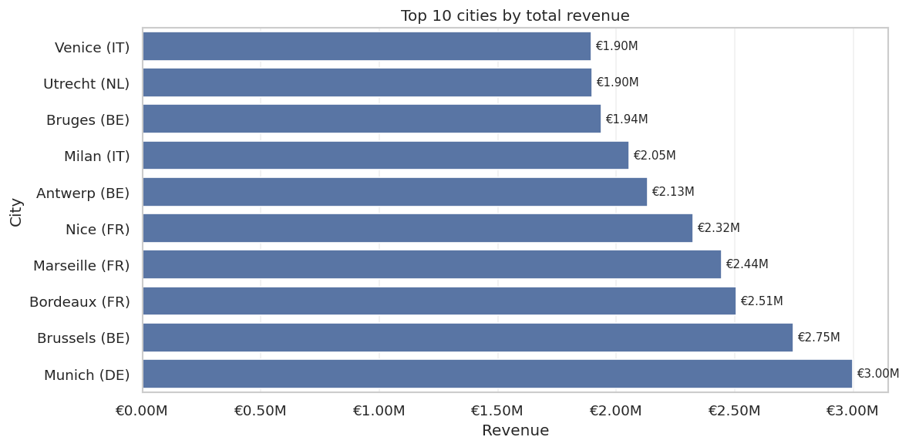
10. Top 10 cities by total revenue
Why: city ranking shows which local markets are most valuable for TravelNest.
Notebook interpretation
Munich (DE) is the strongest-performing city with €3.00M in total revenue. Even the 10th-ranked city, Venice (IT), generated €1.90M, showing revenue is distributed across several urban markets. TravelNest should continue investing in partnerships, marketing and supply across these high-performing cities.
Source: TravelNest_Medallion_Complete.ipynb
13

Slide 14
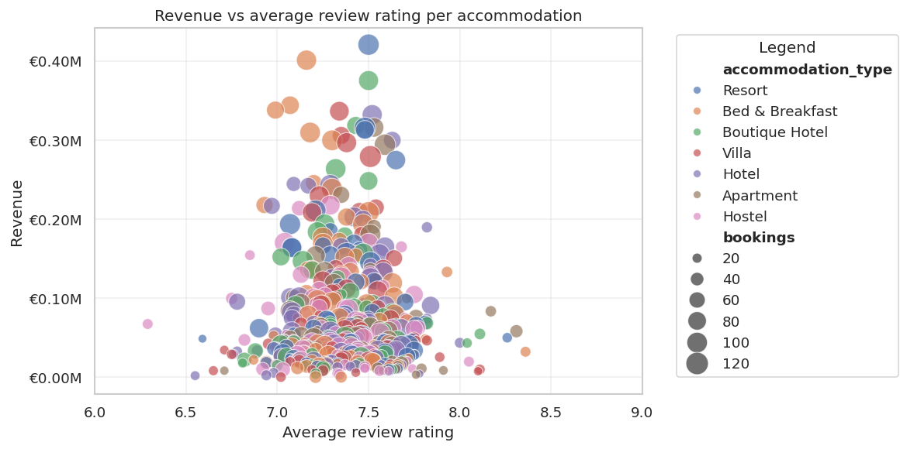
11. Revenue vs average review rating per accommodation
Why: scatter plot evaluates whether quality, measured by review rating, is associated with revenue.
Notebook interpretation
The correlation between revenue and average review rating is -0.02, indicating almost no linear relationship. The highest-performing accommodation, The Garden Resort, generated €0.42M with an average rating of 7.50. Review score alone does not explain revenue. Type, location, pricing and booking volume likely matter more.
Source: TravelNest_Medallion_Complete.ipynb
14

Slide 15
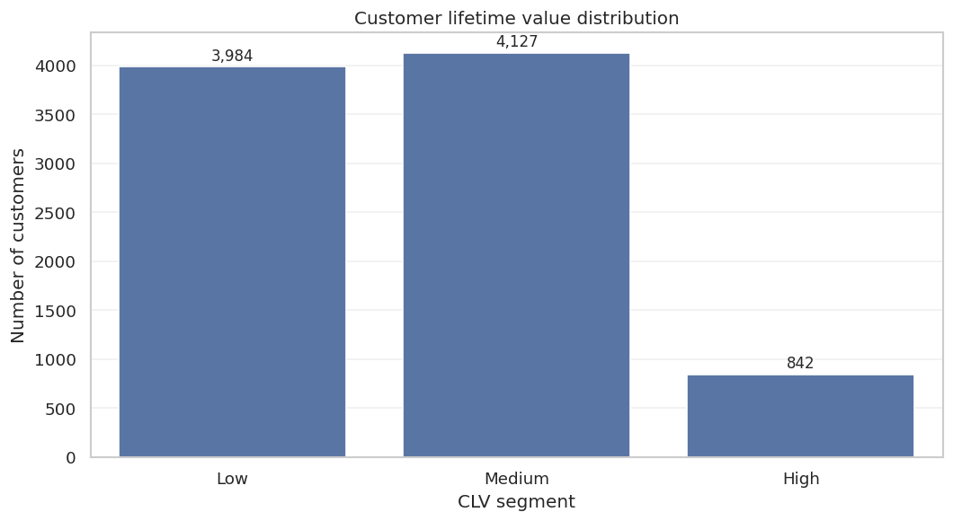
12. Customer lifetime value distribution
Why: CLV segmentation shows how customer value is spread across Low, Medium and High groups.
Notebook interpretation
The Medium CLV segment contains the largest number of customers: 4,127 customers generating €35.99M. The High CLV segment contains only 842 customers, but generates €17.50M and has an average CLV of €20.79K. High-value customers are strategically important for loyalty and retention, while Medium customers form the operational revenue base.
Source: TravelNest_Medallion_Complete.ipynb
15

Slide 16
13. Final answer to management
Supported by the notebook’s Gold model, KPIs and seven mandatory visualisations.
Accommodation type drives revenue
Bed & Breakfast leads with €12.47M, resort follows with €9.87M. Appartement is lowest with 6.5M.
Geography matters
Munich leads city revenue with €3.00M, followed by Brussels and Bordeaux.
CLV depends on retention
Medium CLV customers generate €35.99M. High CLV customers are few but highly profitable.
Cancellations are platform-wide
Country cancellation rates range narrowly from 18.56% to 17.40%.
Quality matters, but not alone
Review rating correlation with revenue is -0.02, so location, type and volume matter more.
Strategic recommendation: expand supply in high-performing cities (Golden Triangle), invest in Bed & Breakfast/Resort partnerships, retain High CLV customers, convert Medium CLV customers upward and improve cancellation management across all markets.
16

